Slide 1
Modern Game AI Algorithms
Final Project : Othello AI Agent
Group 32: Wei Chen, Yijie Lu, Manlu He, Xiaonan Li

Slide 2
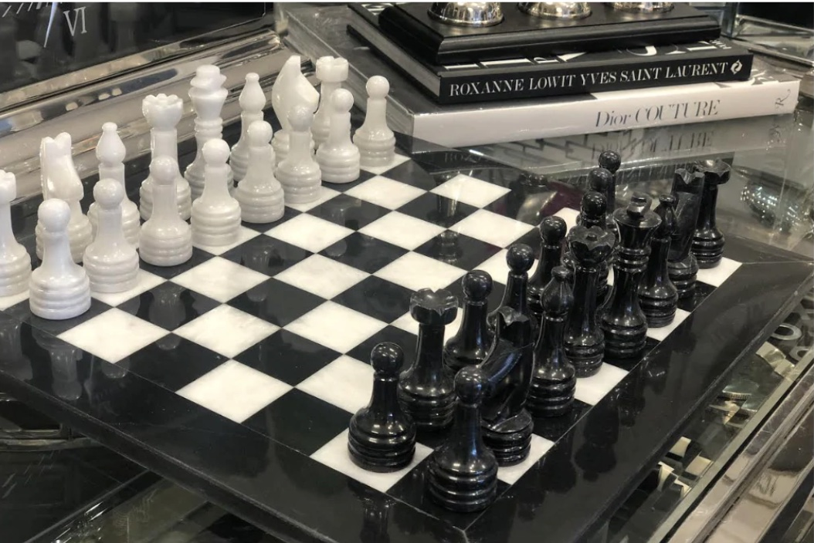
Outline
Project Goals
Othello Game
Inspiration: AlphaGo Zero
Design and Implementation
Let's Play a Game

Slide 3
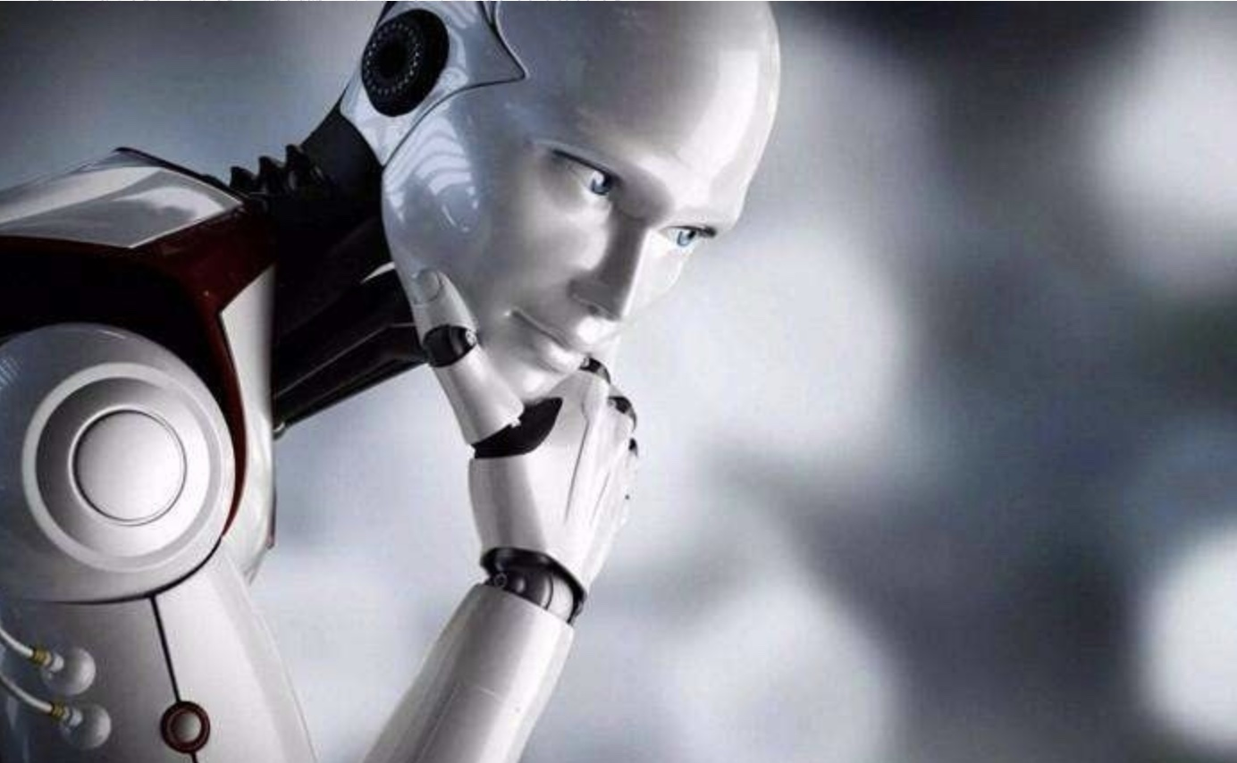
Project Goals
Othello simulator with GUI
human vs human
human vs AI
Othello AI agent

Slide 4
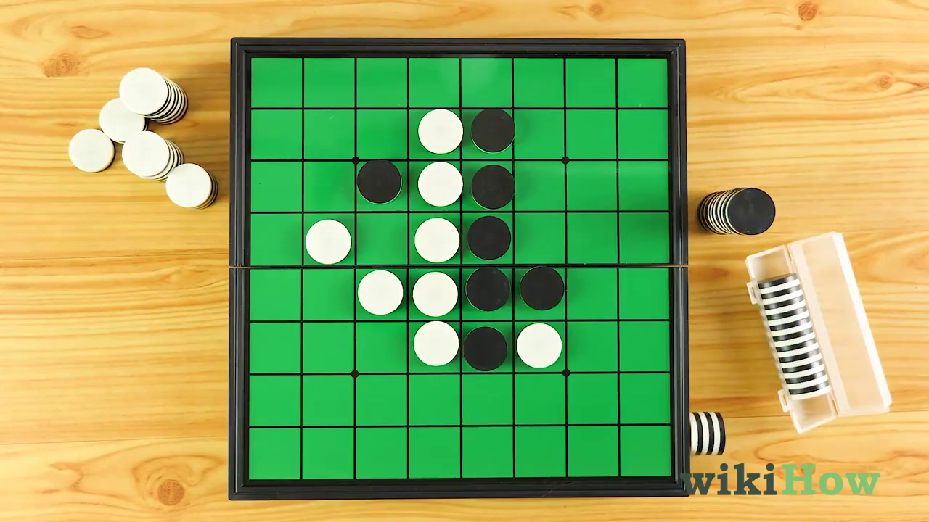
Othello Game
Othello: popular board game (often known as Reversi)
8 × 8 board, black and white tokens
Two players
Rules
Othello Rules

Slide 5
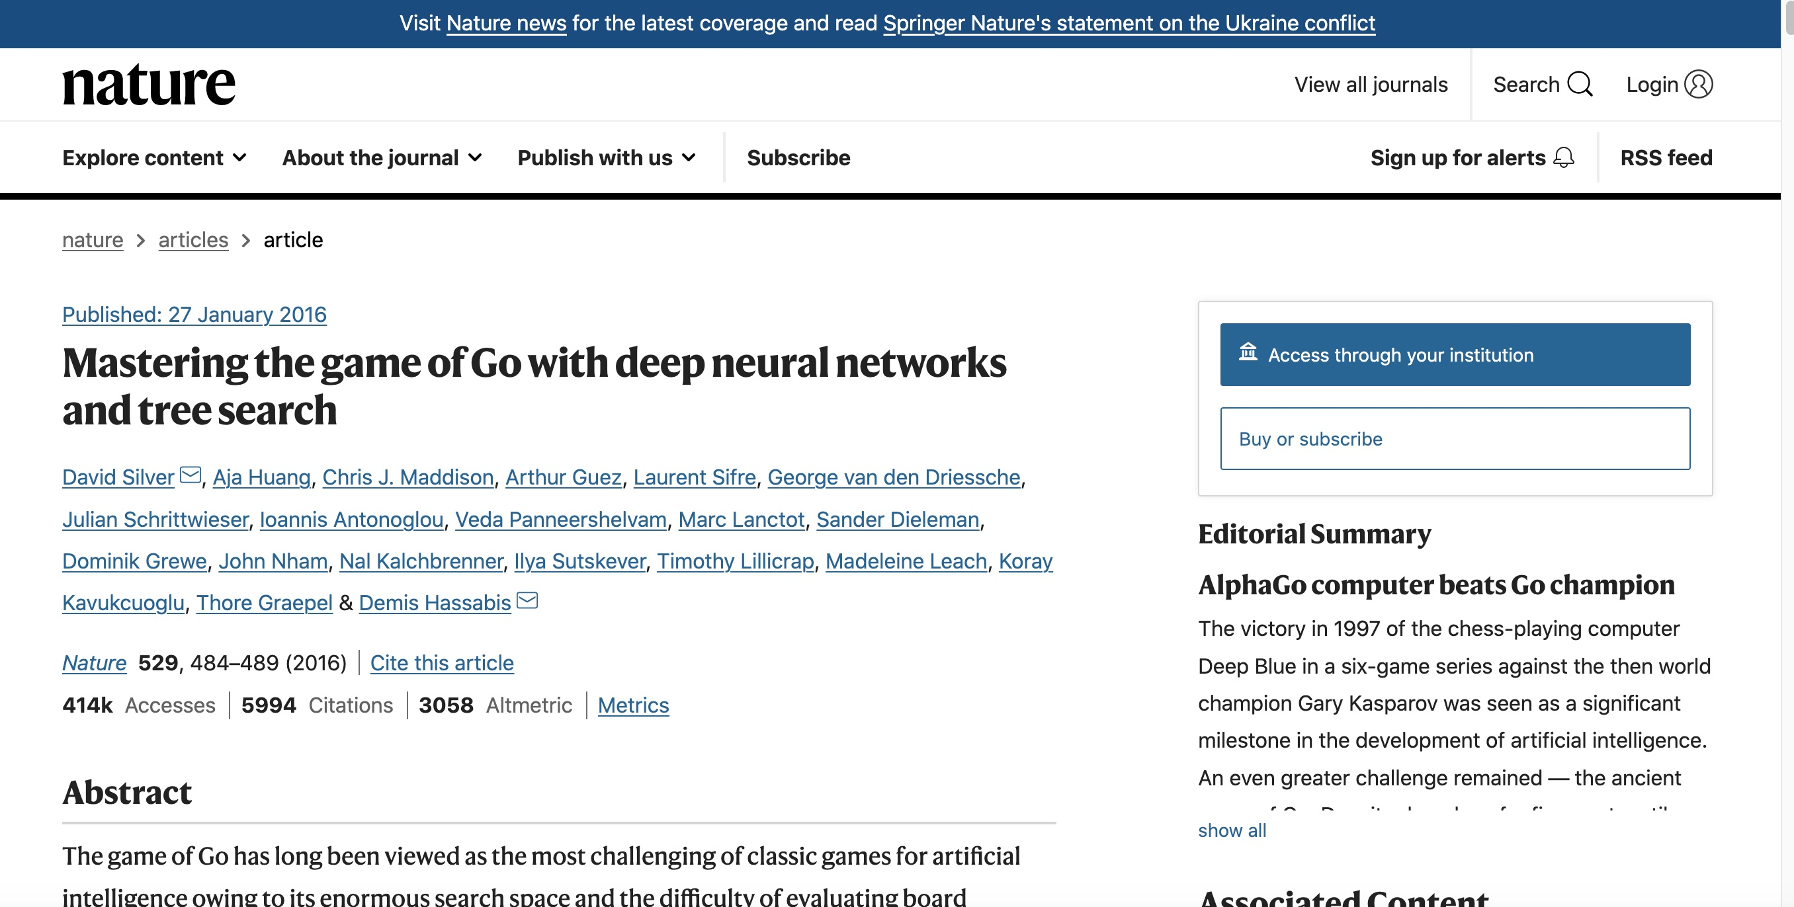
Inspiration: AlphaGo Zero

Slide 6
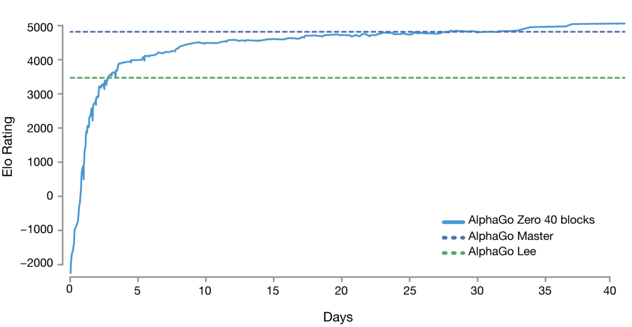
Inspiration: AlphaGo Zero
Start from scratch
Playing against itself
without human games data
Surpass all the old versions

Slide 7
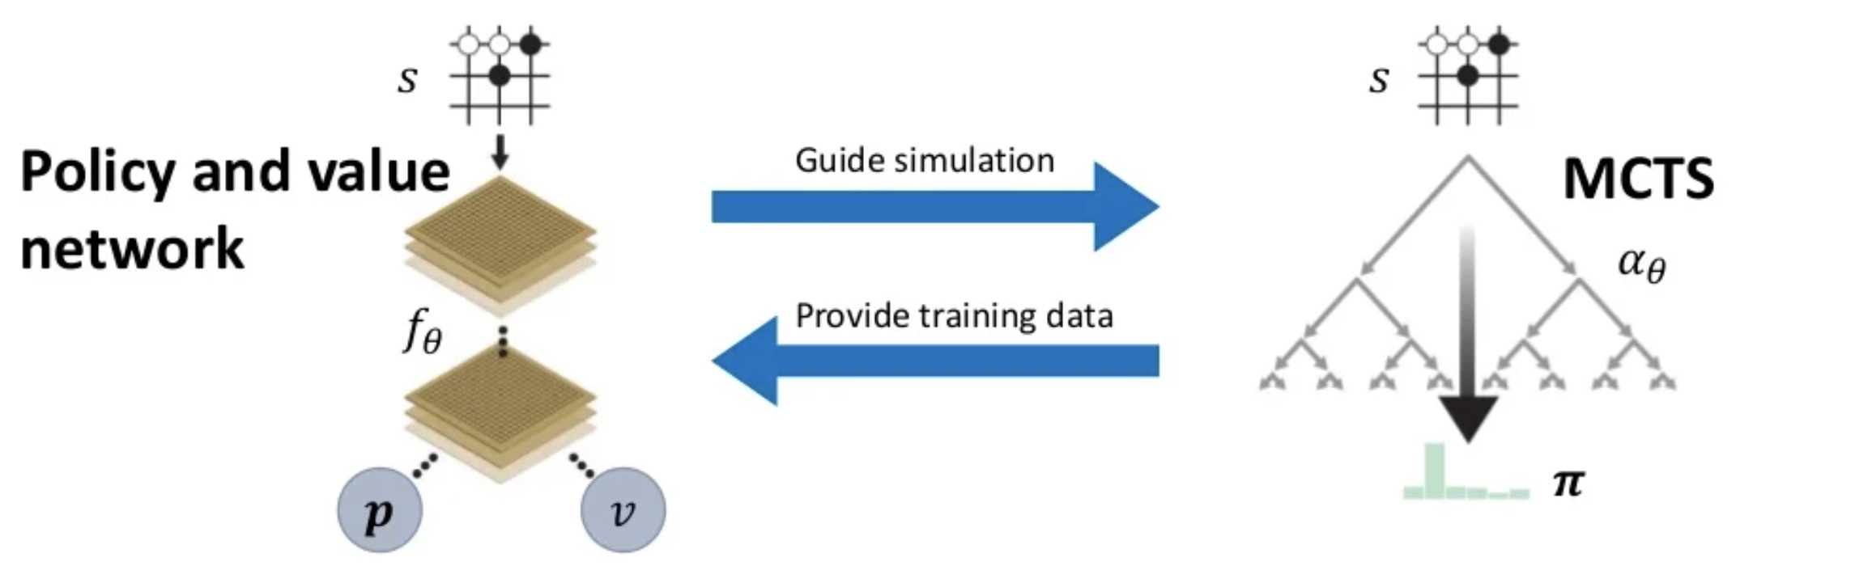
Inspiration: AlphaGo Zero
Two main components(work in parallel)
A policy and value network
Monte Carlo Tree Search(MCTS)

Slide 8
Design and Implementation
Training Model
CNN / ResNet
Models Battle
Current Model vs. Optimal Model
Neural Network
Collect Data
Self-play
Data Augmentation
Input Features
8 × 8 arrays of binary value
Feature #Planes Description
Discs 3 Player, opponent discs or empty
Player 1 Ones if current player is black

Slide 9
Design and Implementation
Monte Carlo Tree Search(MCTS)
Tree Node
Parent node
children nodes
visit time
Q value
cumulative values
Probability
Four steps
Selection - UCB
Expansion
Dirichlet noise
Normal
Simulation - state(game env -> neural network)
Backpropagation

Slide 10
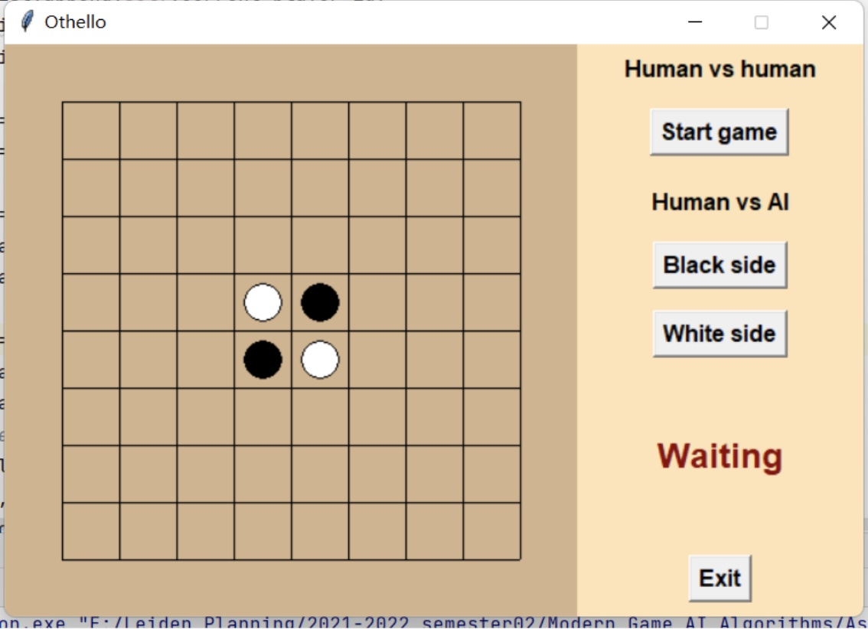
Design and Implement
Technologies:
Agent and Rules:
Python and Pytorch
GUI: tkinter
tkinter

Slide 11
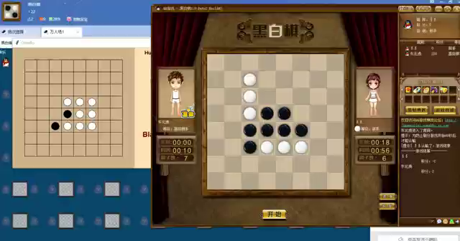
Let's Play a Game

Slide 12
Q&A
Thank you

